Slide 1

An Exploration of NYC Rodent Inspection data and NYC Farmers Market location data

Slide 2

Introduction:
The exploration of the Rodent inspection data and the Farmers Market location data is an attempt to see if there are any correlations between both locations.
Some of the Market locations are open year-round and have cooking demonstrations. This could be a potential food source for rodents year-round.
Rats can transmit diseases to humans, such as Meningitis, Bubonic plague, Rat bite fever, Leptospirosis etc.
Leptospirosis (A blood infection caused by a bacteria) is rarely found in NYC, but the number of people diagnosed in the city has increased in recent years. (Leptospirosis - NYC Health)
The presence of rats in communities has been historically associated with a variety of infectious diseases. Today, rats are principally recognized for their contribution to neighborhood stress, poor quality of life, contamination of food, and for their contribution to the destruction of infrastructure. Mice can contaminate food, and their urine and dander are potent allergens, which can exacerbate the symptoms of asthma in sensitive people. (Mice and rats data for NYC)

Slide 3

Research Questions:
What Boroughs have the highest counts in inspection visits, Baits set, Compliance inspections, Failed inspections and Rat activities?
Are there any correlations between findings in Rodent inspection data and Farmers Market locations?
Does Farmer’s market locations with cooking demonstrations give any additional insight into rodent infestations?
What conclusions can be derived from comparing both data sets?

Slide 4

Data cleaning:
-Removed rows with missing data from the Rodent inspection data set (roughly 17,000 from 2.5million rows of data),
-Created subsets of my dataframes to only include the columns that I am interested in working with.
-Merged both of my data sets,
-Converted data types for visualization and analysis.

Slide 5
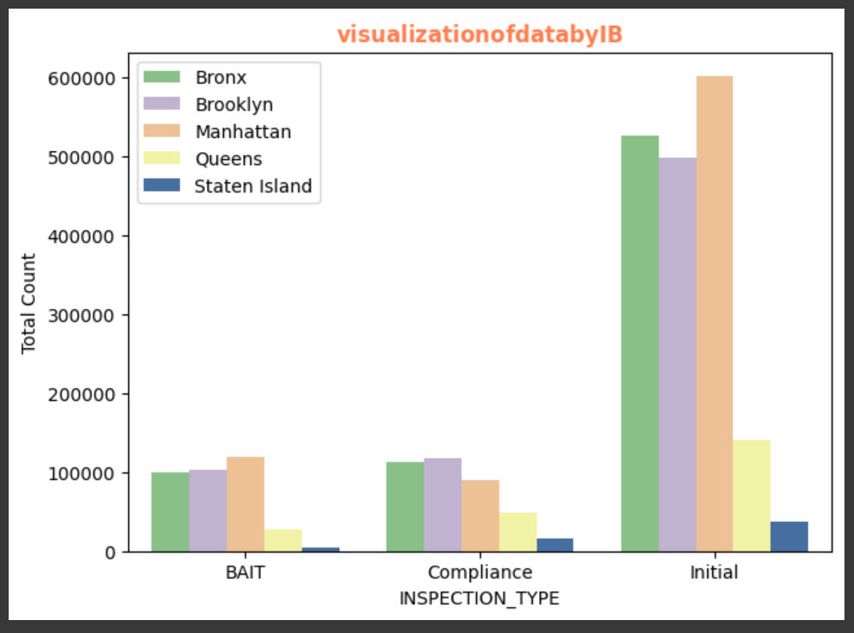
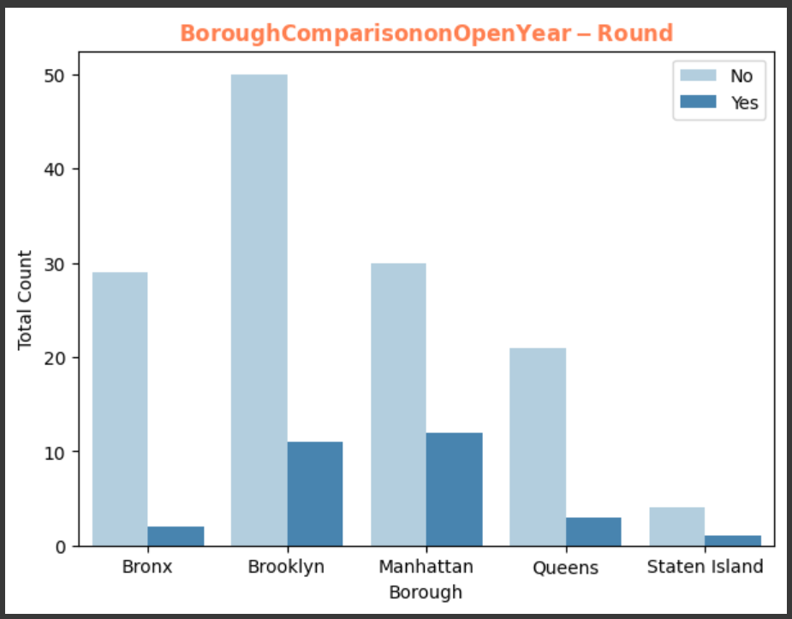
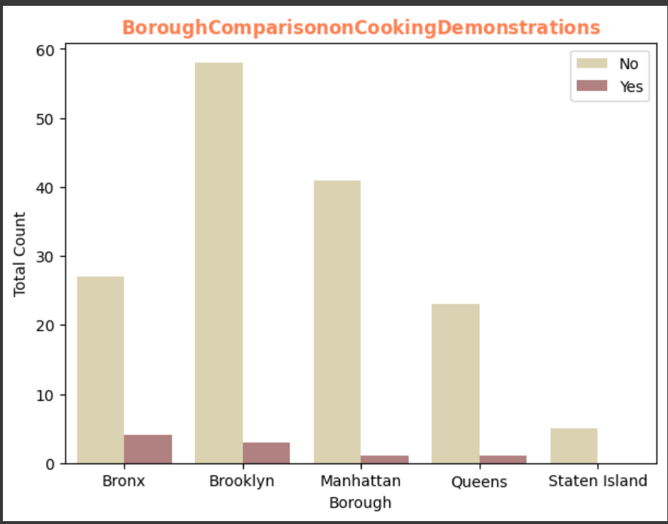
Visualization on data
At the top is the visualization of Inspection by Borough (IB) from Rodent inspection data.
-Manhattan has the most inspections and Baits applied on initial inspection.
-Brooklyn has the highest count in compliance related inspections, with Bronx in 2nd place. Same trend appears in the count of baits applied on initial inspection.
At the bottom is the visualization by Boroughs for cooking demonstrations and locations open year-round from Farmers Market data
- Manhattan has the highest number of markets open year-round, next to Brooklyn
- Data also show that Bronx has more locations with cooking demonstration, next to Brooklyn.

Slide 6

Research Question Answers:
Manhattan has the highest count of Farmers markets open year-round and Brooklyn is 2nd highest
Manhattan has the highest count of Rodent inspections by Borough and next is Bronx
Manhattan has the highest count of Baits applied, while Brooklyn is 2nd runner up
Brooklyn has the highest number of farmers market locations overall, next is Manhattan then Bronx
Brooklyn has highest count in Rodent compliance inspections, and the 2nd highest count of failed results on initial inspections.
Brooklyn has the highest count of Rodent monitoring inspection visits
Bronx has the highest count of cooking demonstration locations, then Brooklyn
Bronx has the highest count in failed inspection results and rat activities, Brooklyn is 2nd highest
Bronx was 2nd behind Brooklyn in compliance inspection counts.

Slide 7

An Exploration of NYC Rodent Inspection data and NYC Farmers Market Location data:
What conclusions can be derived from comparing both data sets?
-Most of the results of the inspections were Passes
-Staten Island has the least counts in Farmers Market locations including open year-round locations and cooking demonstration locations.
-Staten Island also have the least overall Rodent inspection counts.
-There seems to be some correlations between the Rodent inspection data and the Farmers Market data.
-More research/analysis would be required, to get better insight on the root causes of rodent infestations; such as other food sources (e.g. proximities to restaurants, food storage centers, pantries, etc.)

Slide 8
References:
Rodent inspection data (2.56 million rows and 25 columns). Last update at time of data download was May/15/2024.
Rodent Inspection | NYC Open Data (cityofnewyork.us)
NYC Farmers Market data (163 rows and 16 columns). Last updated Jan/31/2024.
NYC Farmers Markets | NYC Open Data (cityofnewyork.us)
Information on Leptospirosis
Leptospirosis - NYC Health
Mice, Rats and Health information
Mice and rats data for NYC
Pandas API Reference
API reference — pandas 2.2.2 documentation (pydata.org)

Slide 9
THANK YOU
Tolulope Ajide
Specialist

